Slide 1

DESCRIPTIVE, DIAGNOSTIC & FORECAST ANALYSIS OF PASSENGER FLIGHT IN JUANDA SURABAYA AIRPORT BASED ON GOOGLE TREND FROM 2011 TO AUGUST 2023
RIZAL IMADUDDIN YUSAN (6032222109)
SURYO UTOMO (6032222062)
MOCHAMMAD REYHAN MAULUDDI (6032222003)
MUHAMMAD FACHRY NOVA (6032222061)
DEFRIKO CHRISTIAN D (6032222098)

Slide 2
Contents
How to describe the analysis of big data on the trend of domestic and international air traffic managed by Juanda Surabaya Airport based on the number of passengers and air operators data in the year 2011 to August 2023 related to mobility trends during COVID-19, trends in gold price and oil price ?
Understand the characteristics of passengers and air operators based on domestic and international flight traffic data of Juanda Surabaya Airport from 2011 to August 2023
Juanda International Airport (SUB) is the third busiest airport in Indonesia
Background
Research Question
Objective
Future Work
Data Source & Variable
Result, Insight & Discussion
Conclusion
Air Passenger Forecasting with macroeconomic indicators, commodity prices, and mobility data as additional predictor variables
1.511.660 of rows
28 features (variables)
range data from 2011-August 2023
The analysis made of various aspects :
Annual Passenger Traffic by Airline
Monthly Passenger Traffic Heatmap
Traffic share by Destination
The Peak points traffic airlines (Monthly, Days and holidays)
Diagnostic Analysis
Predictive Analysis (ARIMA, LSTM, Prophet)
Explain Descriptive Analysis for Airlines Traffic
Explain Diagnostic Analysis effect Airlines Traffic by Covid Data Mobility, Gold Price & Oil Price
Explain Predictive Analysis by time series forecasting

Slide 3
Company Profile, Background & Objective
Company Profile
Background
Objective
Juanda International Airport (JIA) (Indonesian: Bandar Udara Internasional Juanda) (IATA: SUB, ICAO: WARR), is an international airport located in Sedati, Sidoarjo. It is now the third busiest airport in Indonesia (after Soekarno-Hatta and Ngurah Rai airport). This airport is located approximately 12 kilometers (7.5 mi) from Downtown Surabaya and serves the Surabaya metropolitan area, the metropolitan area of Surabaya plus extended urban area. Juanda International Airport is operated by PT Angkasa Pura I^{[1]}. The aviation sector is severely affected by Covid pandemic where the aviation industry suffered a loss of $126.4 billion in 2020 and 2021 $47.7 billion. Air passenger traffic decreased by -60%.
The challenges global aviation industry is experiencing financial recovery, with 2022 marking a turning point in traffic recovery
Juanda International Airport (SUB) development focuses on creating an integrated network to enhance industrial activities, employing the superhub, hub, and spoke concept
The study employs historical passenger data from Juanda Airport (2011-2020) for forecasting models, utilizing Google Trends as an exogenous variable to gauge public interest in air travel-related topics
The forecasting models include ARIMA for trends and seasonal patterns, LSTM for nonlinear characteristics, and Prophet for integrating seasonal components, trends, and external variables
The research aims to provide more accurate predictions of Juanda Airport's passenger numbers, incorporating insights from Google Trends. Model evaluation will use statistical metrics like MAE, RMSE, and MAPE.
The research potential impact extends to offering valuable guidance for authorities and stakeholders involved in planning, capacity management, infrastructure development, flight planning, operational management, and marketing strategies in (SUB)
Furthermore, the findings of this research can assist in improving flight planning, operational management, and marketing strategies at the airport
PowerPoint Presentation

Slide 4
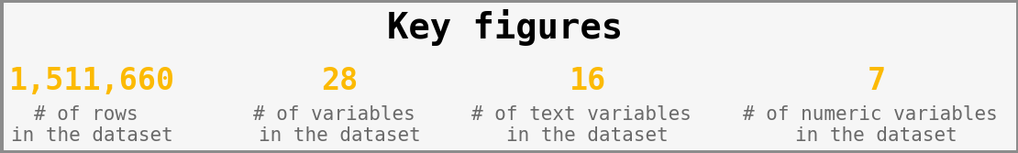
Literature Study, Data Source & Variable
Literature Study
Data Source
"The Success of Lufthansa in Adding Value to Its Business through the Shift from a Selling Dominant to a Service Dominant Mindset Using Big Data."
“Big data is being mined to discover innovative service provision and operational optimizations that were not possible before.”
(Chen, 2016)
“We observe a negative and statistically significant stock price reaction to the announcement of COVID-19
as a global pandemic to the airline industry in US”
(Martins, 2022)
“The optimal weights for gold were substantially higher than those of other assets, reaching a peak during the pandemic, implying that investors consider gold a flight-to-safety asset”
(Nassar, 2023)
Data were sourced from PT Angkasa Pura I Airport Collaborative Decision Making System (SIOPSKOM X-CDM), Yahoo Finance, and Google Mobility Data
List of Important Variables
Variable | Description | Data Type
Activity Period | Date of Flight | DateTime
OPERATOR | Airline | Text
DOIN | Domestic/International | Category
Passenger Count | Paying, Infant, Transfer | Integer
GC=F | Gold Price | Continuous
CL=F | Oil Price | Continuous
Mobility Score | Covid - Indonesia Google Mobility Score | Continuous

Slide 5
Related Works
Time Series Forecasting Models Used:
ARIMA and Exponential Smoothing which are the traditional methods.
LSTM neural networks effectively capture long-range dependencies.
Prophet, developed by Facebook, is suitable for strong seasonality and holiday effects.
Hybrid Forecasting Approaches:
Researchers combined strengths of ARIMA, LSTM, and Prophet models.
Enhances accuracy and robustness of predictions.
Application of Models:
ARIMA and Exponential Smoothing for traditional forecasting.
LSTM for capturing long-range dependencies.
Prophet for datasets with seasonality and holiday effects.
Exogenous Variables in Forecasting:
Incorporating external factors like economic indicators and online search trends improves accuracy.
Google Trends data provides insights into public interest and influences time series data.
Research Context:
Specific emphasis on the aviation industry and Juanda Airport.
Goal is to develop a comprehensive forecasting framework.
Practical Significance:
Forecasting assists in capacity planning and operational decision-making.
Hybrid models provide a more accurate understanding of temporal patterns.
Future Works:
Building upon existing studies to develop a robust forecasting framework.
Further exploration of hybrid models and the incorporation of additional exogenous variables.

Slide 6
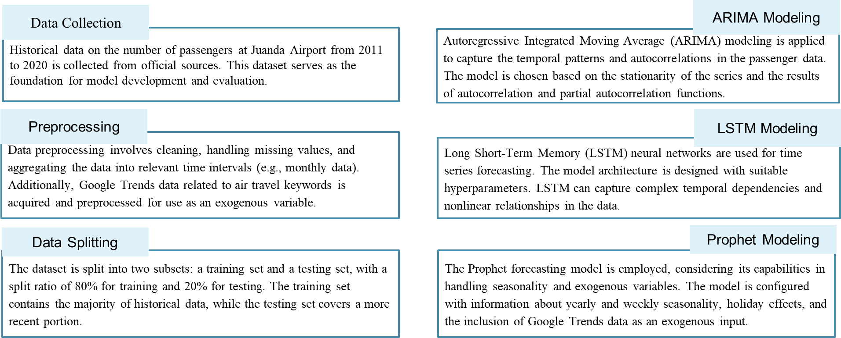
Theory and Methodology

Slide 7
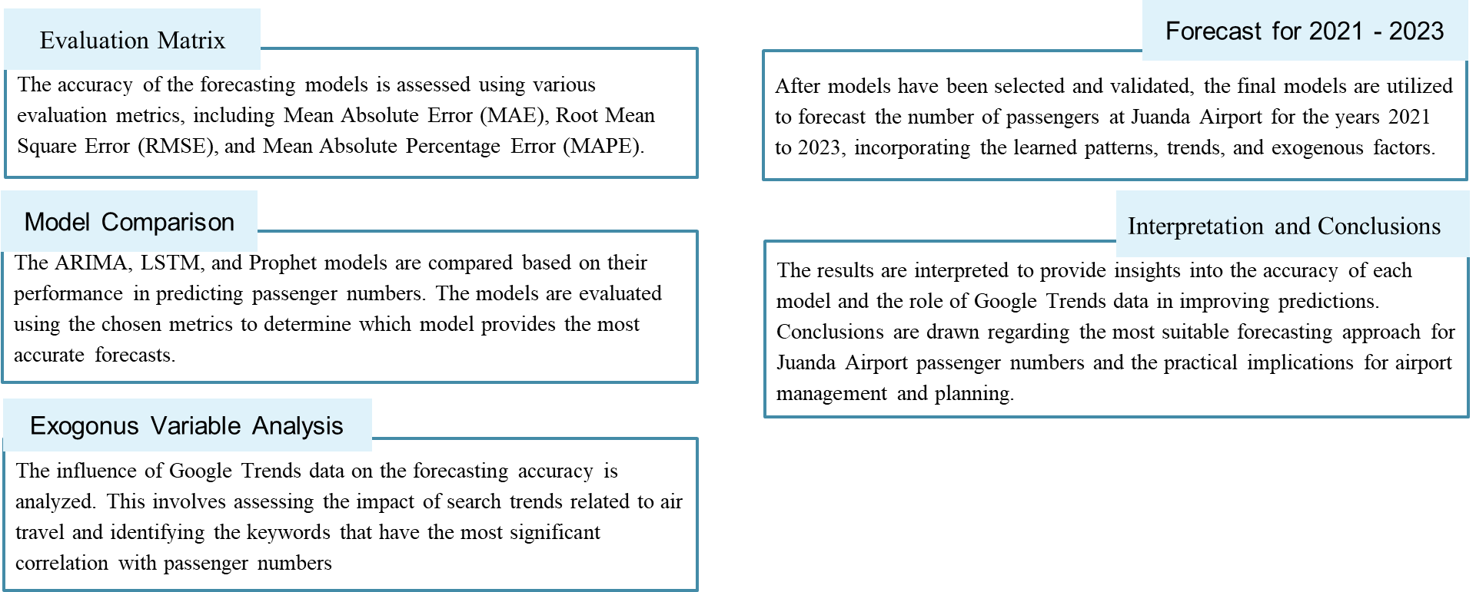
Theory and Methodology

Slide 8
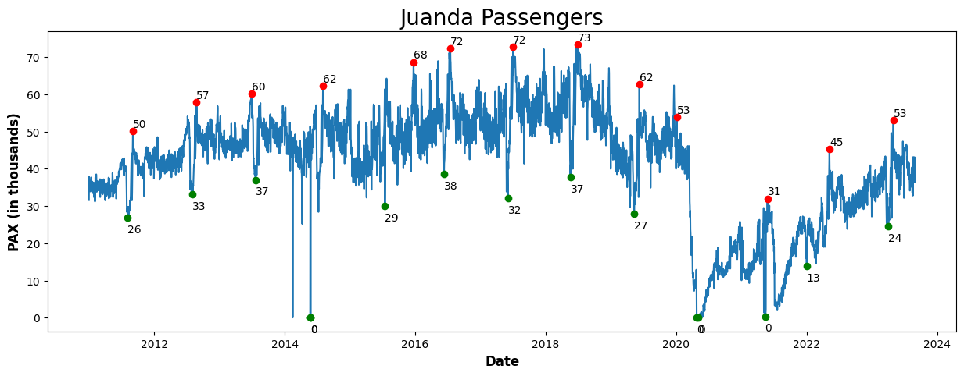
Descriptive Analysis Highlight
Passengers traffic steadily grows from 2011 through 2019 and 2022 through 2023, drastically decreases in 2020 due to Covid 19 effects.
The highest number of passengers is reported so far from 2017 through 2019 between 72 - 73 thousands passengers
There are few zero numbers. The first zero number is reported on 2014 because of kelud volcanic eruption and the second and third zero number are in 2020 because of Covid 19 lockdowns.

Slide 9
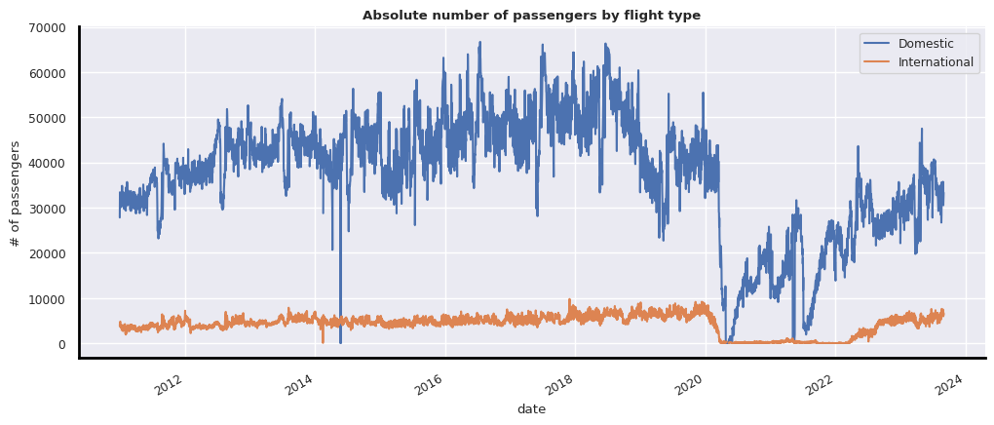
Traffic share by Destination
Based on international and domestic categories, Juanda Airport is predominantly dominated by domestic flights overall.
For domestic traffic, in 2023 the number of passengers has not experienced an increasing trend as it did before 2019.
In 2020, there was an extreme decrease to the point of reaching zero due to the impact of COVID on the airlines industry

Slide 10
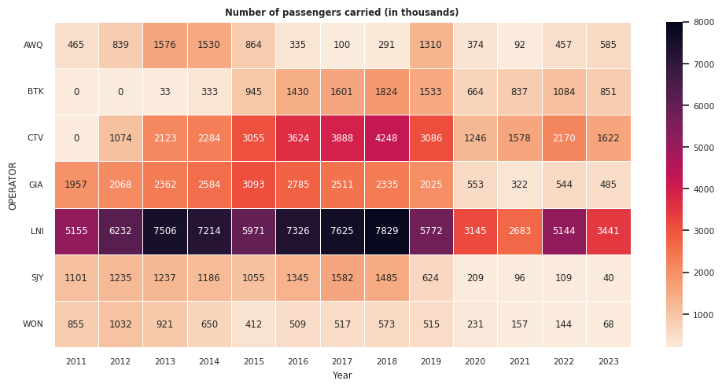
Annual Passenger Traffic by Airline
The heatmap shows seven most dominating airline operators for annual passenger traffic in Juanda Airport. Lion Air is the most dominant among them.
Passengers traffic steadily grows from 2011 through 2018 but from 2019 through 2023 drastically decreases because of covid 19’s effects.
In 2023 the number of passengers has not experienced an increasing trend as it did before 2019.
The highest number of passengers is reported so far is in 2016-2018. Lion Air has the most dominating number of passengers of all operators.
Airlines Operators :
AWQ = Air Asia 4. GIA = Garuda Indonesia 7. WON = Wings Air
BTK = Batik Air 5. LNI = Lion Air
CTV = Citilink 6. SJY = Sriwijaya

Slide 11
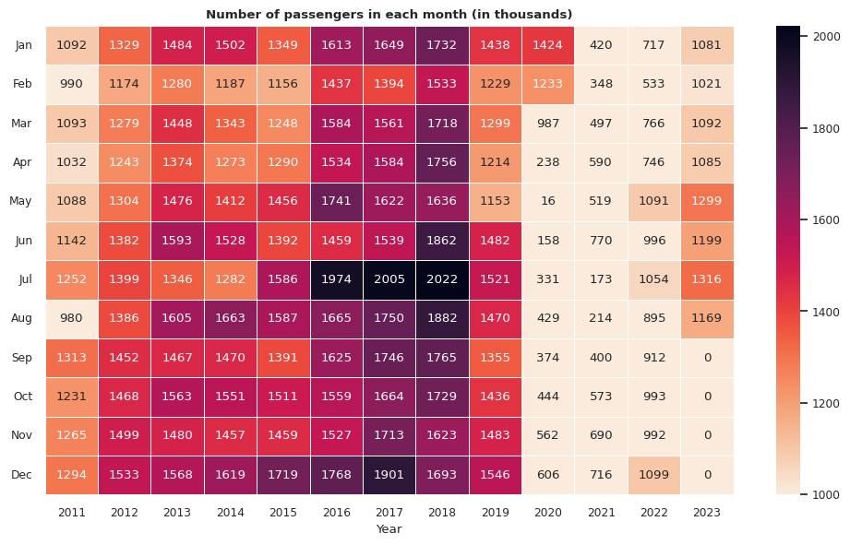
Monthly Passenger Traffic Heatmap
The heatmap shows monthly passenger traffic in Juanda Airport from 2011-2023.
Passengers traffic steadily grows from 2011 through 2018 but from 2019 through 2023 drastically decreases because of covid 19’s effects.
In 2023 the number of passengers has not experienced an increasing trend as it did before 2019.
The highest number of passengers is reported so far is in 2016-2018.
July-Dec has the peak of monthly passenger traffic every year from 2011-2019
Feb has the smallest number of monthly passenger traffic every year from 2011-2019..

Slide 12
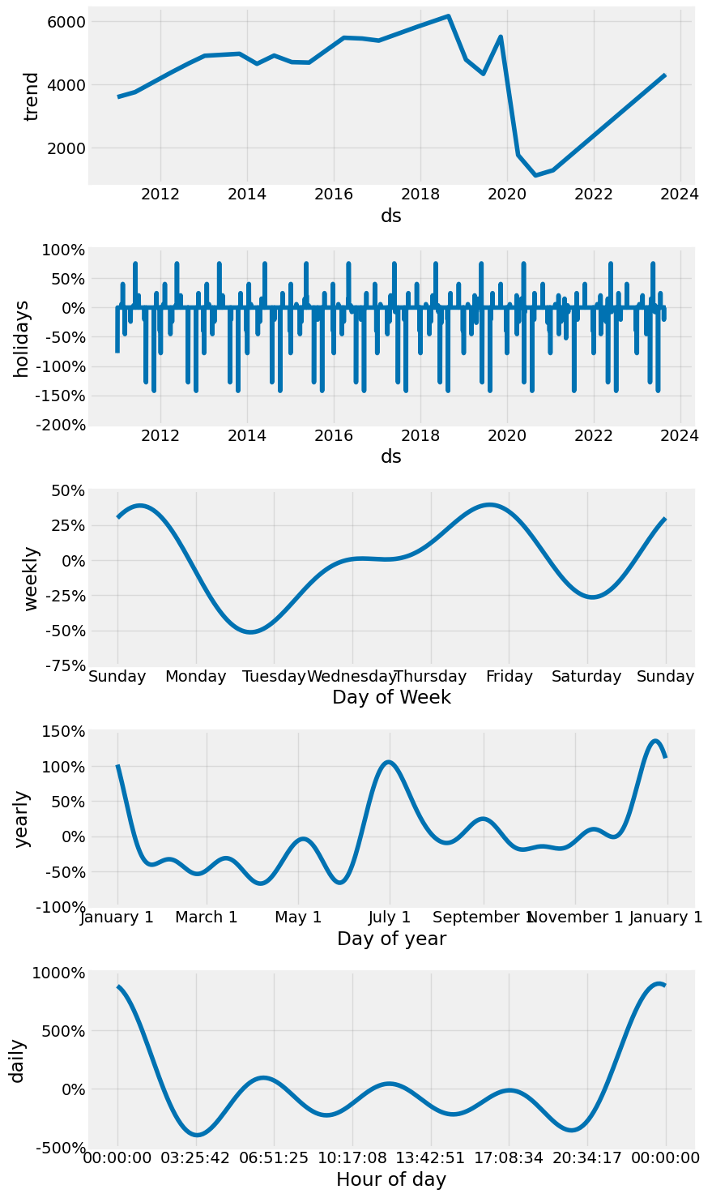
Time Series Decomposition
There are two peak points every year from 2011-2023. The peak points are in July (School Holiday) and December (Christmas and New Year Holiday).
There are two trough points every year from 2011-2023. The trough points are in April and June.
There are two weekly peak points from 2011-2023. The peak points are in Sunday and Friday.
There is one weekly trough points every year from 2011-2023. The trough point is in Tuesday.
On the holiday, there is a negative effect on passenger decreasing number. This occurs because customers travel on the day before the holiday.

Slide 13
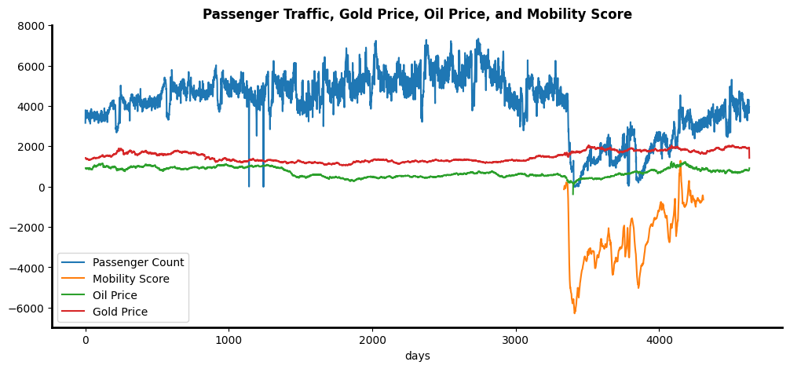
Diagnostic Analysis
The trend in passenger traffic has significantly declined during the COVID-19 pandemic. This is in line with the decreasing mobility score trend.
The emergence of COVID-19 has caused the price of gold to rise.
On the contrary, the emergence of COVID-19 has caused the movement of global oil prices to decrease due to the global economic downturn.

Slide 14
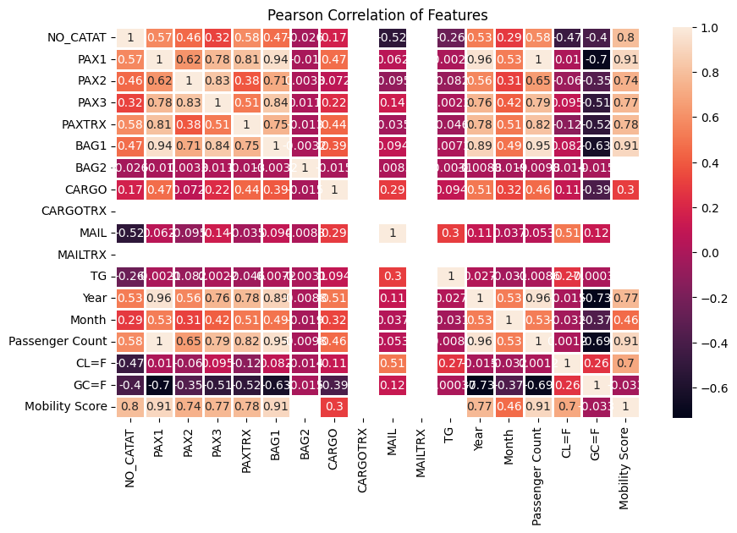
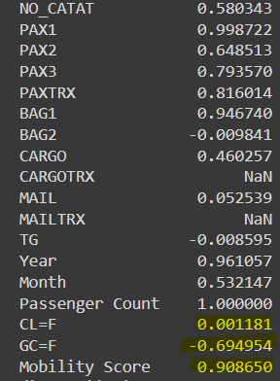
Diagnostic Analysis: Correlation
The number of passengers has a negative correlation with the price of gold (GC=F) with a coefficient of -0.69
The number of passengers has a very small positive correlation with the global oil price (CL=F) with a coefficient of 0.001.
The number of passengers has a great positive correlation with the mobility score with a coefficient of 0.9

Slide 15
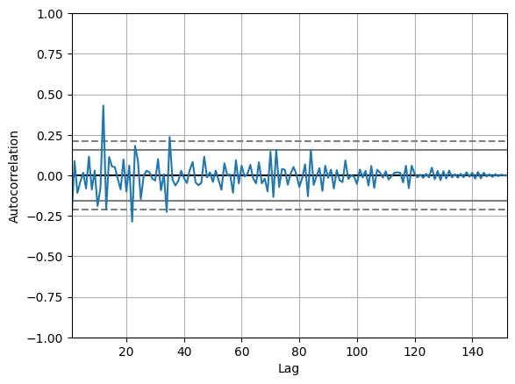
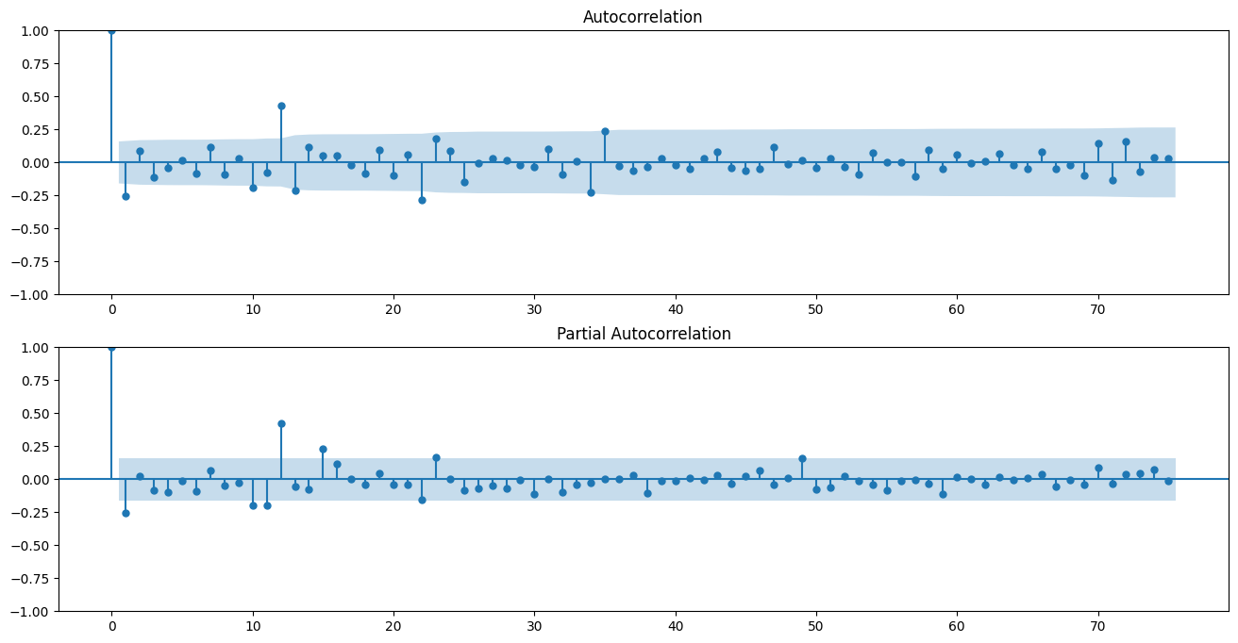
Time Series Forecasting: ARIMA
Based on the ACF and PACF plots, we can select the appropriate orders (p, d, q) for ARIMA model. The orders represent the number of autoregressive terms (p), differencing (d), and moving average terms (q) in the model.

Slide 16
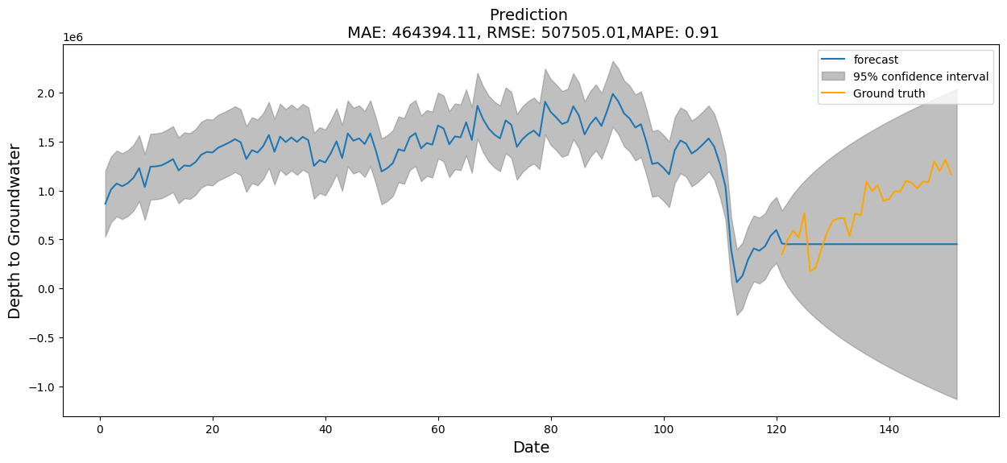
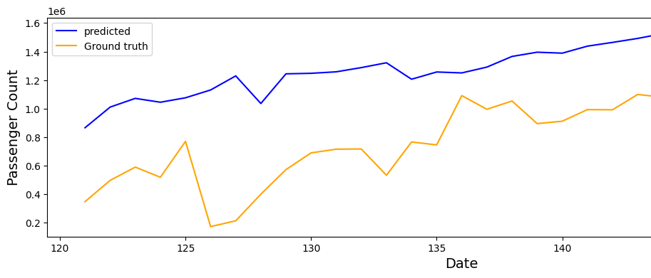
Time Series Forecasting: ARIMA
The RMSE for the ARIMA model is approximately 507,505
The MAPE for the ARIMA model is approximately 0.906, which is equivalent to 90.6%. A lower MAPE signifies a more accurate forecast.

Slide 17
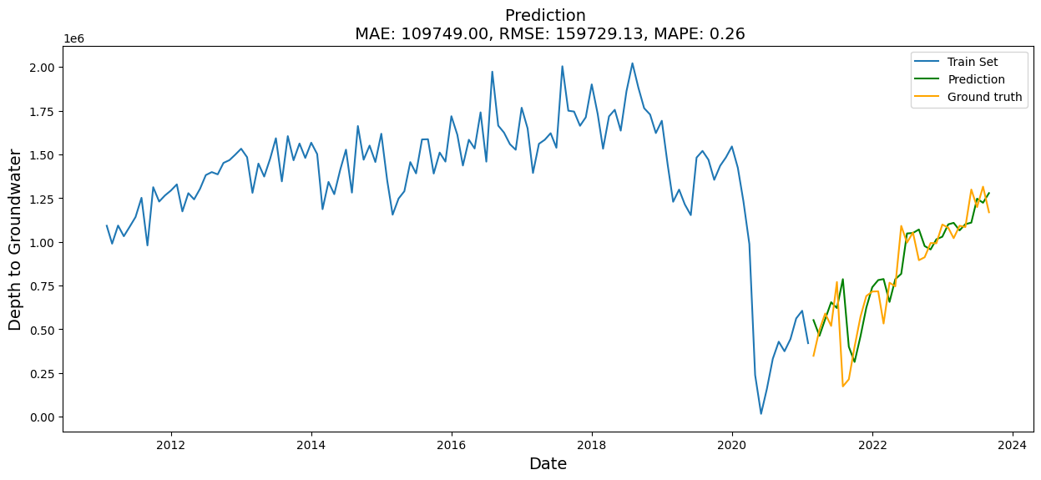
Time Series Forecasting: LSTM
The RMSE for the LSTM model is approximately 159,729
The MAPE for the LSTM model is approximately 0.261, which is equivalent to 26.1%

Slide 18
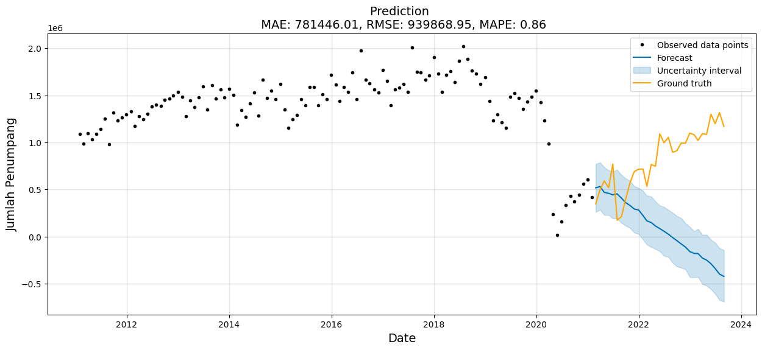
Time Series Forecasting: Prophet
The RMSE for the Prophet model is approximately 939,869
The MAPE for the Prophet model is approximately 0.863

Slide 19
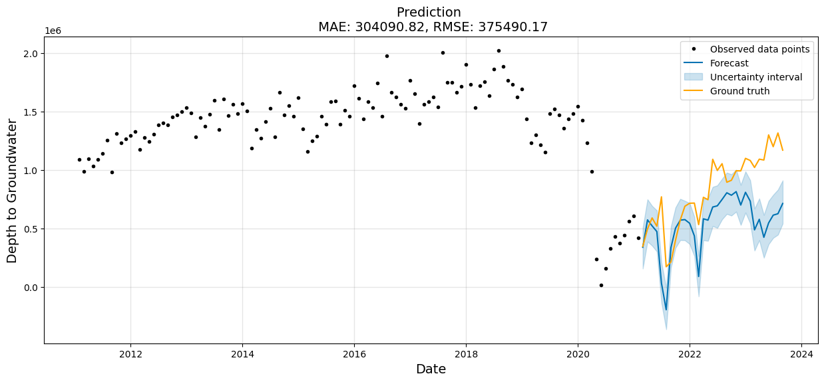
Time Series Forecasting: Prophet with Exogenous Variable
The RMSE for the Prophet model with exogenous variables is approximately 363,306
The MAPE for the Prophet model with exogenous variables is approximately 36.87%

Slide 20
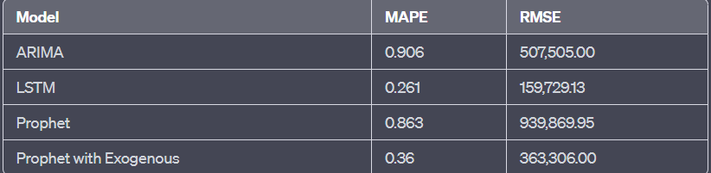
Time Series Forecasting: Model Performance Summary
The LSTM model stands out as the most accurate model among the evaluated approaches, as it achieved the lowest RMSE and MAPE.
The ARIMA model also provides reasonably accurate predictions, outperforming both the Prophet models.
The inclusion of Google Trends data as exogenous variables in the Prophet model improved its forecasting accuracy, reducing the MAPE from 0.863 to 0.36. However, this model still fell short of the LSTM and ARIMA models in terms of accuracy

Slide 21
Descriptive & Diagnostic Conclusion
Forecasting Model Conclusion
The study aimed to forecast the number of passengers at Juanda Airport from 2011 to 2023.
Four different forecasting models were applied and evaluated for their accuracy. Results showed significant differences in forecasting accuracy among the models.
The Long Short-Term Memory (LSTM) model emerged as the most accurate, achieving the lowest Root Mean Squared Error (RMSE) and Mean Absolute Percentage Error (MAPE).
The Autoregressive Integrated Moving Average (ARIMA) model also provided reasonably accurate predictions, outperforming the Prophet models.
The Prophet model, when supplemented with Google Trends data as exogenous variables, improved forecasting accuracy by reducing MAPE from 0.863 to 0.36.
Despite the enhancement with exogenous variables, the Prophet model still fell short of the accuracy achieved by the LSTM and ARIMA models.
Passengers traffic steadily grows from 2011 through 2018 but from 2019 through 2023 drastically decreases because of covid 19’s effects.
In 2023 the number of passengers has not experienced an increasing trend as it did before 2019.
Based on international and domestic categories, Juanda Airport is predominantly dominated by domestic flights overall.
Lion Air is the most dominant among the seven dominant airlines operators.
There are two peak points every year from 2011-2023. The peak points are in July (School Holiday) and December (Christmas and New Year Holiday).
The number of passengers has a negative correlation with the price of gold (GC=F) with a coefficient of -0.69.
The number of passengers has a great positive correlation with the mobility score with a coefficient of 0.9

Slide 22
References
Annual Report PT Angkasa Pura I Tahun 2022
Chen, H.M. Schutz, R. Kazman, R. Matthes, F. “Amazon in the Air: Innovating with Big Data at Lufthansa.” Hawaii International Conference on System Sciences 2016 49th.
Khafidli, MK., Choiruddin, A.: Forecast of Aviation Traffic in Indonesia Based on Google Trend and Macroeconomic Data using Long Short-Term Memory. 2022. International Conference on Data Science and Its Applications (ICoDSA)
Nassar, S. Boubaker, S. Chaibi, A. Makram, B. “In search of hedges and safe havens during the COVID─19 pandemic:
Gold versus Bitcoin, oil, and oil uncertainty.” Quarterly Review of Economics and Finance 90 (2023): 318-332.
Martins, A.M. Cro, S. “Airline stock markets reaction to the COVID-19 outbreak and vaccines: An event study.” Journal of Air Transport Management 105 (2022) 1-10.
Zachariah, RA., Sharma, S., Kumar, V. Systematic Review of Passenger Demand Forecasting in Aviation Industry. 2023. Multimedia Tools and Applications
https://www.google.com/covid19/mobility/
BPS Provinsi Jawa Timur. Statistik Transportasi Provinsi Jawa Timur Tahun 2022.

Slide 23
Lampiran, Data Source Dll
Colab Notebook: https://drive.google.com/file/d/1ZMrzCP0ZYQ0lfOIMbL4CNgyt5L1pGTXU/view?usp=drive_link

Slide 24
THANK YOU

